Slide 1

Sturents
Enjoy Renting!

Slide 2
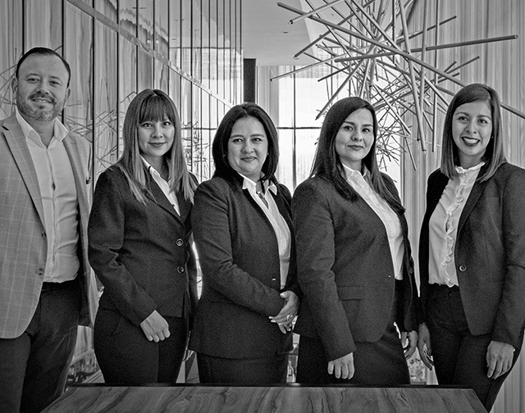
ABOUT US
RA2011030010039 (Ashish Varma)
RA2011030010048 (Kaushik Tayi)
RA2011026010246 (Mayank Reddy Ankilla)
RA2011031010120 (Aditya Yalavarthy)
RA2011027010210 (Suraj Rauniyar)
RA2011003011373 (Manisha Edison)

Slide 3

PROBLEM
We as students know how difficult it is to find things at the last minute, and especially during exams when we require calculators and other stationary items.
There’s only so much that shops can provide to students, as entire university depends on those shops, there won’t be enough stock to fulfill everyone’s needs
Even though students order it online, it would take forever for the product to reach them.
Students have suffered a lot during exams and this was an incident that I have personally seen happening to my fellow classmate.
This is the problem statement of our project.

Slide 4

SOLUTION
So we have come up with the product idea where students can rent/buy products from other students present in the university.
How cool is that???.
A set of policies and guidelines will be imposed by us on how the renting/selling process is to be done.
All the students present in the university will be enrolled to this and start renting their products when not in use.
By doing so, every student gets an opportunity to get any item on time at the very last minute and can also have an advantage in meeting new people at the same time.
Any problem arises, our helpdesk will be 24/7 online to help you with any query.

Slide 5
BUSINESS MODEL
1
2
3
Marketplace Model
On-demand Model
Disintermediation Model
The marketplace model is a type of business model that allows you to act as the go-between for sellers and buyers. Likely the most popular company to use the marketplace model is Amazon. They only act as the online marketplace that takes care of the transactions between buyers and sellers.
The on-demand model is exactly as it sounds, which means that you will be tasked with providing customers with a service that they can request and obtain any time they please. Uber is a top example of this business model that allows customers to request a ride, after which a driver will pick them up and take them to their destination. Other businesses that use this model handle all kinds of on-demand services for everything from the beauty industry to the laundry and dry cleaning industry.
The disintermediation model is a standard business model that's used by a wide range of wholesalers, manufacturers, and businesses that offer direct sales. The goal of this model is to get rid of the middleman, which lowers the cost of doing business for the manufacturer. The main benefit of using this business model is that the end-user should be able to pay a much lower cost than they normally would for a product or service.

Slide 6
MARKET OPPORTUNITY
our market opportunity is to rents the products , which are on the high demand for the period of time from an
another person which it not useful for that period of time
our product mainly focus on the university students
so, when they need a product they can rent themselves
because there will be near a range of area and
they can also save a lot of time
By using our product they can also built there circle
among juniors and seniors

Slide 7
COMPETITION
our product will not have a competition
from some period of time,because
our product will collaborate with the
college and will be one of it products
from renting apps as for now
we may have some competitions after
a period of time because , some other students may show a product similar or
better than us

Slide 8
COMPETITION PART 2
More Convenient
security
database
improving algorithm
and data analysis
More Expensive
Less Expensive
no support from university
advertisements
Less Convenient

Slide 9
GROWTH STRATEGY
our product will ensure the
security of personal information of the students
and will ensure the product
quality and will deal with the
large amount of products
our product will collaborate
with the university and use
the data base of the university and can expand
to a very broad range of
students
Our product at the starting
phase mainly advertize
about the famous product
and mainly focus on
product availability
and integrity rather
than security
‹#›

Slide 10
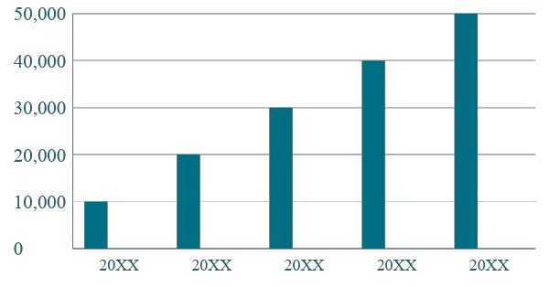
TRACTION
Key Metrics
Revenue by Year
 | Users | Orders | Gross Revenue | Net Revenue
2022 | 100 | 1100 | 10,000 | 7,000
2023 | 200 | 200 | 20,000 | 16,000
2024 | 300 | 300 | 30,000 | 25,000
2025 | 400 | 400 | 40,000 | 30,000
2026 | 500 | 500 | 50,000 | 40,000
2022
2023
2024
2025
2026
‹#›

Slide 11
FINANCIALS
 | 2022 | 2023 | 2024
Users | 200 | 300 | 400
Jobs | 6 | 12 | 18
Average price per job | 1000 | 5000 | 7000
COMPANY REVENUE @15% | 10000 | 20000 | 30000
- Cost of Revenue | 5000 | 9000 | 12000
Gross Profit | 15000 | 25000 | 35000
OPEX
- Sales & Marketing | 0 | 0 | 0
- Customer Service
- Product Development | 10% | 10% | 10%
- Misc. | 10% | 10% | 10%
TOTAL OPEX | 5000 | 7000 | 10000
‹#›

Slide 12

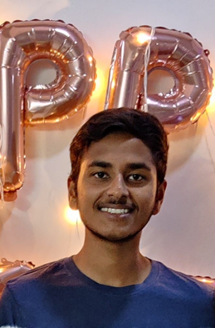

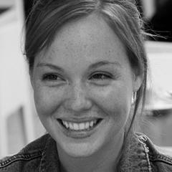

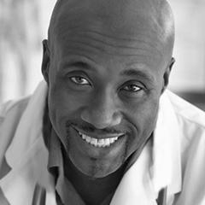

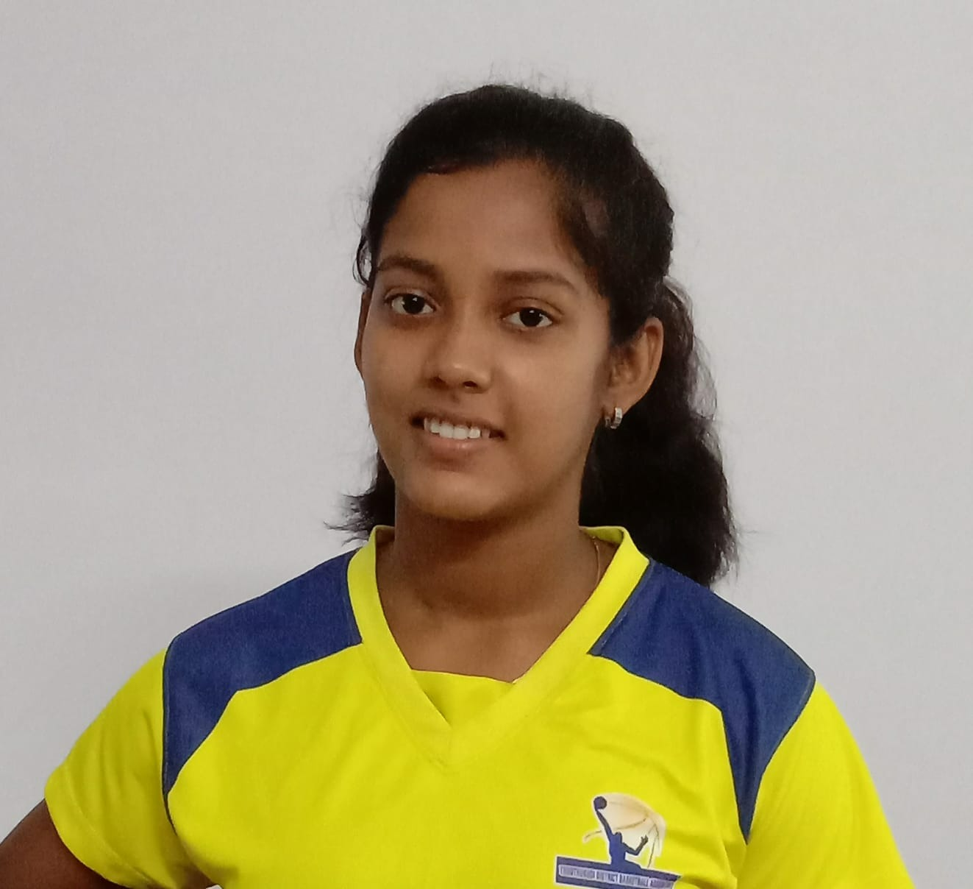
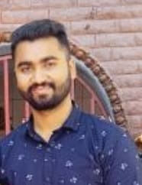
OUR TEAM
Ashish Varma
Ashish Varma
Team Member Title
Mayank R A
Mayank Reddy Ankilla
Team Member Title
Kaushik Tayi
Kaushik Tayi
Team Member Title
‹#›
Aditya Yalavarthy
Manisha Edison
Suraj Rauniyar

